Slide 1
Python for Data Science
Intro to Data Science
Spring 2018

Slide 2


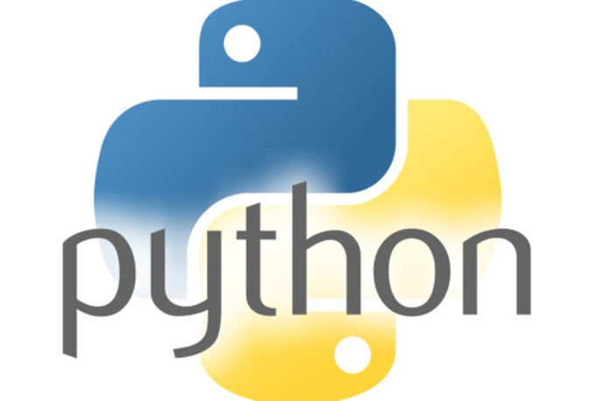

What is Python?
z
Open source, multi-purpose programming language, just like R!
Generally considered a good balance of speed, power, flexibility, and human-friendliness
Used for lots of things besides data science
This Photo by Unknown Author is licensed under CC BY

Slide 3
Why use Python for Data Science?
Free
Reliable, fast, and powerful data science libraries
Active community maintaining and updating
Plenty of applications in both academia and private sector
z

Slide 4
Okay sure, but why not just use R then?
z
Python generally higher-performance for large-scale cases
Interacts well with other languages, especially for making interactive tools or applications
Very popular in industry, especially with non-data-sci programmers

Slide 5
Python vs R
R
Python
Built ground-up with data and statistics in mind
Great visualization tools
Great for research papers
Inefficient for non-data science applications
General purpose, but with good data science tools
Follows a lot of “typical” programming conventions
Great for putting code “into production”

Slide 6
Which one is better?
At this point, it really does come down to personal preference
In many professional contexts, people really do code at very advanced levels using both of these (unlike Stata)
Being able to read and understand both will give you the flexibility to join teams that prefer one or the other
New languages do get developed, so knowing how to learn a new language will make sure your skills don’t become obsolete

Slide 7
Key differences to learn
Development environments
Data types and storage conventions
Indexing and lookups
Formatting
Libraries for data science
z

Slide 8
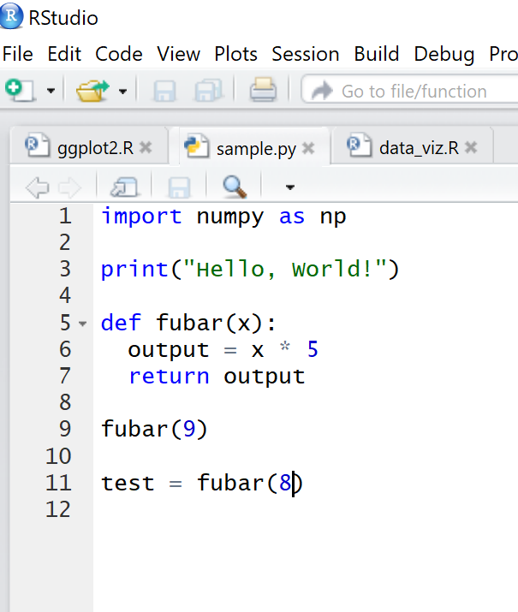

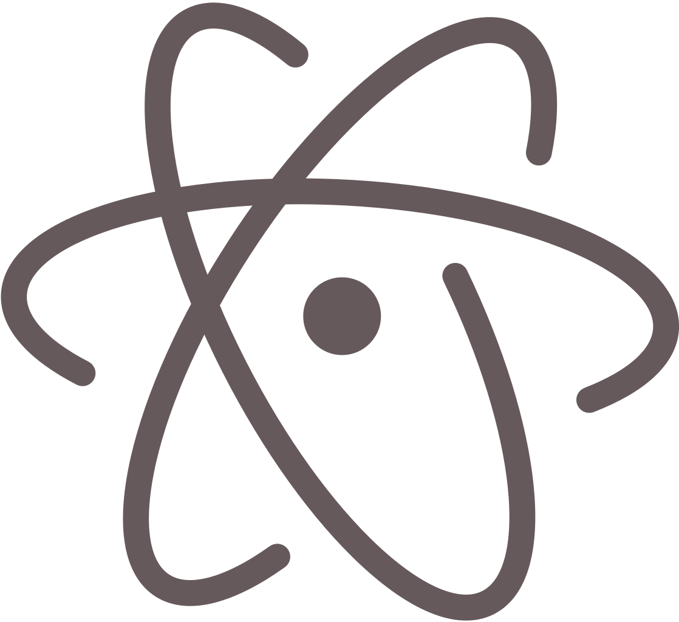

Development environments
z
How do you beat RStudio?
This Photo by Unknown Author is licensed under CC BY-SA
This Photo by Unknown Author is licensed under CC BY-SA
This Photo by Unknown Author is licensed under CC BY-SA

Slide 9
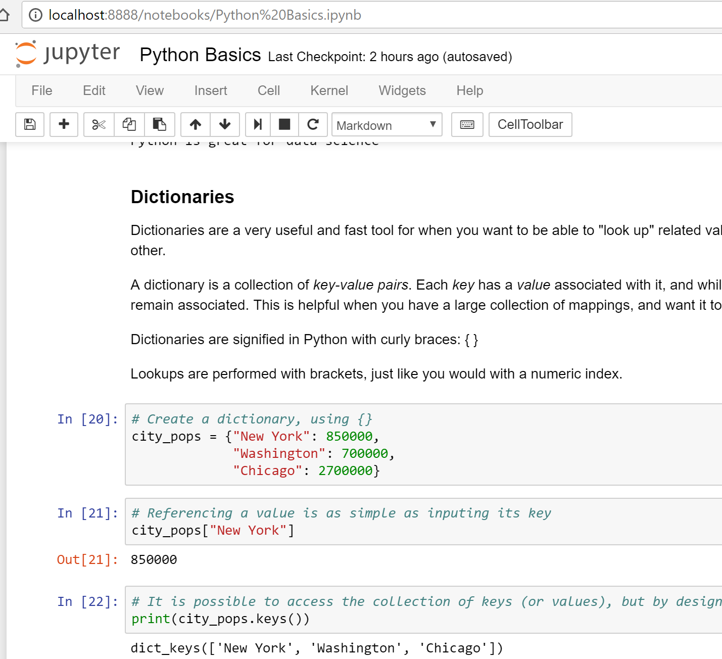
Development Environment: Jupyter notebooks
z
z

Slide 10
Zero-based indexing
Very important!
In R, ranges and indeces are one-based and inclusive
[12, 28, 13, 5, 2, 4, 18]
1 2 3 4 5 6 7
[1:6] includes 1 and 6
[12, 28, 13, 5, 2, 4]

Slide 11
Zero-based indexing
In Python, ranges and indeces are zero-based and exclusive
[12, 28, 13, 5, 2, 4, 18]
0 1 2 3 4 5 6
[1:6] starts at the second element, and does not include 6
[28, 13, 5, 2, 4]

Slide 12
Formatting: Indents matter!
myFunc <- function(arg){
output <- arg*2
return(output)
}
In R, curly braces show the outside “levels” of functions or loops, and indents just help readability.
def myFunc(arg):
output = arg*2
return output
In Python, curly braces mean something completely different, and the indents are necessary to group code together.

Slide 13
A quick introduction to methods
A method is a special kind of function that is associated with a specific type of object or data type.
An array of numbers would have a mean method
A DataFrame could have a method to summarize the included data in various ways
R doesn’t really have them, Python and some other languages do.

Slide 14
A quick introduction to methods
Methods are called by putting .method_name() at the end of the object performing the method
df.head()
names.length()
Don’t use periods in your variable or function names in Python!

Slide 15
Useful libraries for each
R | Python
Mathematical and statistical operations
Base R | numpy, scipy
Data cleaning and data frames
Base R | pandas
Regression analysis
Base R (lm and glm) | scikit-learn
Advanced Machine Learning
Specialized packages (RandomForest, tree, NbClust) | scikit-learn
Data visualization
ggplot | matplotlib

Slide 16
Good resources for practicing
DataCamp – free and paid online tutorials for R and Python data science skills
HackerRank – challenges and competitions to practice programming and math skills
Codecademy – interactive online lessons for general Python programming (not so much data science skills)

Slide 17
Let’s code!
z

